Slide 1
DRONE WITH SURVALIENCE CAMERA
GUIDED BY:
Ms.B.Akhila
Mrs.R.Sridevi

Slide 2
Content
Abstract
Block diagram
Components
Advantages
Applications
Process of making

Slide 3
Abstract:
The Live-streaming Quadcopter Drone with Integrated Camera is a versatile aerial vehicle designed for capturing high-quality live video footage. It features four rotors for stable flight, advanced control algorithms, and a long-lasting battery system. The integrated camera system ensures smooth and clear visuals, compensating for drone movements. The ground station acts as a central hub for receiving and processing the live video feed, providing real-time monitoring, control, and recording capabilities. This innovative drone opens up opportunities for aerial photography, videography, surveillance, and live streaming, offering a unique perspective and vantage point.

Slide 4
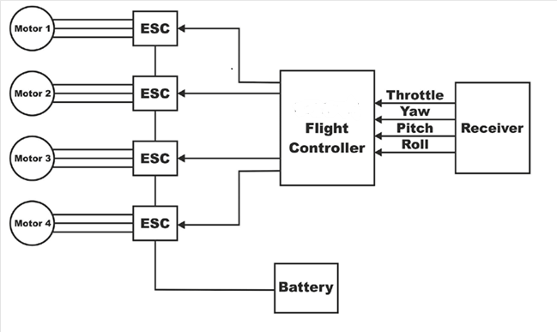
BLOCK DIAGRAM

Slide 5
COMPONENTS:
ESC 30A
BATTERY 5200 3SmAh 11.1V
BRUSHLESS MOTORS 1400KV
10 INCH PROPELLERS (1045R)
QUADCOPTER FRAME (POWER DISTRIBUITION BOARD IS INCLUDED IN IT)
FLIGHT CONTROLLER KK 2.1.5
FLY SKY FS-i6

Slide 6
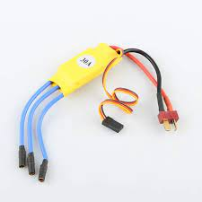
.
ESC 30A:
The term "ESC" typically stands for "Electronic Speed Controller." It's a device that controls the speed and direction of a brushless motor. A 30-amp ESC can handle a continuous current of up to 30 amps. The principle behind an ESC involves receiving control signals from a receiver (often from a remote control transmitter) and then modulating the power supplied to the motor to regulate its speed and direction. This modulation is usually achieved by rapidly switching the flow of current through different phases of the motor.
Modern ESCs also often come with additional features like motor braking, smooth acceleration, and sometimes even built-in safety features to prevent overheating or damage to the motor and ESC itself.

Slide 7
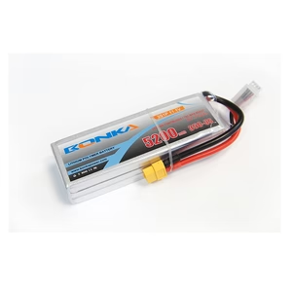
BATTERY:

Slide 8
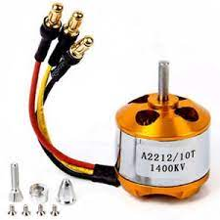
Brush less motors1400kv:

Slide 9
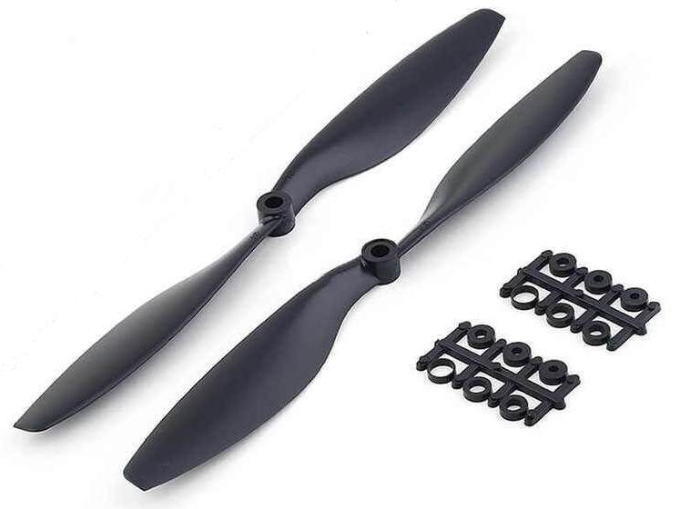
Props and quadcopter frame

